Slide 1
EDA on Netflix Dataset
An analysis of trends in genres, ratings, and popularity.

Slide 2
Project Overview & Objectives
Project Scope: An Exploratory Data Analysis (EDA) on a dataset of 9,827 movies and TV shows from 'mymoviedb.csv'.
Objective: To clean, analyze, and visualize the data to uncover trends, patterns, and key insights into the content library.
Key Columns Analyzed: The analysis focused on `Title`, `Release_Date`, `Popularity`, `Vote_Average`, and `Genre`.
Initial Dataset: The raw data contained 9,827 unique titles with no initial missing values or duplicates.

Slide 3
Data Preprocessing
Date Transformation: The `Release_Date` column was converted from an object to datetime, and then simplified to extract only the **Year** for trend analysis.
Feature Reduction: Dropped non-essential columns (`Overview`, `Original_Language`, `Poster_Url`) to focus the analysis on key metrics.
Data Integrity: Confirmed the dataset was complete with zero duplicate rows or null values, ensuring a clean foundation for analysis.

Slide 4


Feature Engineering: Unlocking Insights
1. Categorizing Ratings
2. Exploding Genres
The numerical `Vote_Average` (0-10) was statistically categorized into four balanced groups based on quantiles (quartiles).
Titles with multiple genres (e.g., "Action, Adventure") were split. The dataset was "exploded" so each genre gets its own row.
•
Popular
This was a critical step, expanding the dataset from 9,827 to 25,552 rows for highly accurate genre analysis.
•
Average
•
Below Average
•
Not Popular

Slide 5
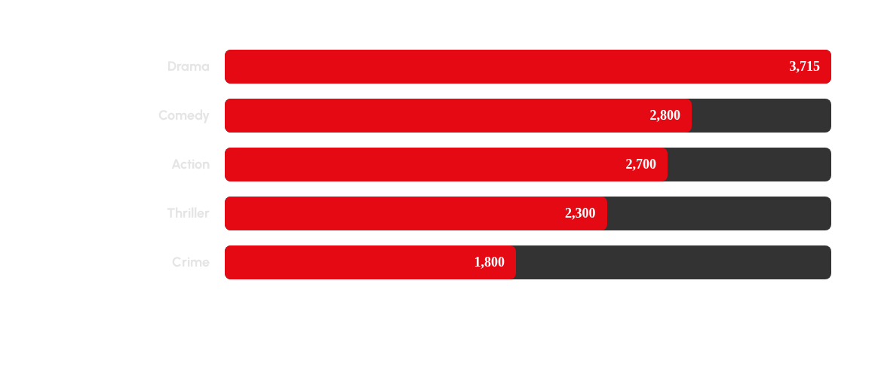
Finding 1: Most Frequent Genre
Answer: 'Drama' is the most frequent genre, appearing 3,715 times (over 14% of all genre entries).

Slide 6
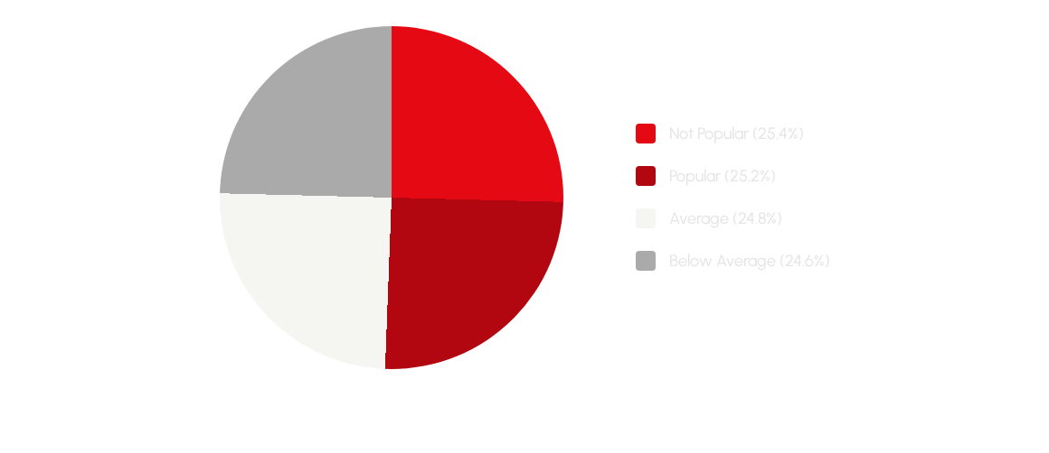
Finding 2: Rating Category Distribution
Answer: The titles are very evenly distributed across the four rating categories, with each representing ~25% of the dataset.

Slide 7


Finding 3: The Popularity King
Highest Popularity Movie
Movie: 'Spider-Man: No Way Home'
This title had the highest popularity score in the entire dataset by a significant margin.
Genres:
•
Action
•
Adventure
•
Science Fiction

Slide 8


Finding 4: The Lowest Popularity Titles
'The United States vs. Billie Holiday'
'Threads'
The second film tied for the lowest popularity score.
One of two films tied for the lowest popularity score in the dataset.
Genres:
•
War
Genres:
•
Drama
•
Music
•
Science Fiction
•
Drama
•
History

Slide 9
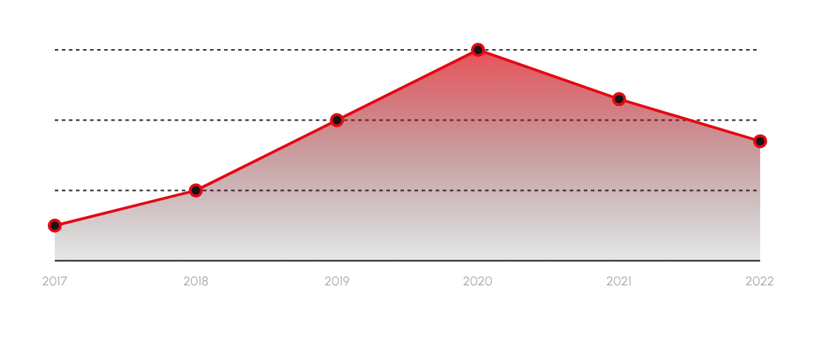
Finding 5: Peak Year for Releases
Answer: The year 2020 saw the highest number of releases, marking the peak of content production in this dataset.

Slide 10
Key Conclusions
Dominant Genre: 'Drama' is the most frequent and dominant genre across the dataset.
Peak Popularity: 'Spider-Man: No Way Home' (Action, Adventure, Sci-Fi) is the most popular title.
Lowest Popularity: 'The United States vs. Billie Holiday' and 'Threads' were the least popular.
Peak Year: 2020 was the benchmark year for the highest volume of content releases.
Rating Balance: Titles are evenly distributed across all four custom-defined rating categories (Popular, Average, etc.).

Slide 11

Thank You

Slide 12


Image Sources
http://www.movieposters.com/cdn/shop/products/255053349_408225954164881_580470973376990445_n_1024x1024.jpg?v=1637860151
Source: www.movieposters.com
https://static.vecteezy.com/system/resources/thumbnails/029/465/075/small/red-curve-on-a-black-background-vector.jpg
Source: www.vecteezy.com

